Slide 1
Introduction to
Data Mining

Slide 2
Objectives
Purpose of online analytical processing (OLAP) and how OLAP differs from data warehousing.
Key features of OLAP applications.
Potential benefits associated with successful OLAP applications.
Rules for OLAP tools and main types of tools including: multi-dimensional OLAP (MOLAP), relational OLAP (ROLAP), and managed query environment (MQE).

Slide 3
Objectives
OLAP extensions to SQL.
Concepts associated with data mining.
Main data mining operations including predictive modeling, database segmentation, link analysis, and deviation detection.
Relationship between data mining and data warehousing.

Slide 4
Acknowledgments
These slides have been adapted from Thomas Connolly and Carolyn Begg

Slide 5
Data Warehousing and End-User Access Tools
Accompanying growth in data warehouses is increasing demands for more powerful access tools providing advanced analytical capabilities.
Key developments include:
  Online analytical processing (OLAP).
  SQL extensions for complex data analysis.
  Data mining tools.

Slide 6
Introducing OLAP
The dynamic synthesis, analysis, and consolidation of large volumes of multi-dimensional data, Codd (1993).
Describes a technology that uses a multi-dimensional view of aggregate data to provide quick access to strategic information for purposes of advanced analysis.

Slide 7
Introducing OLAP
Enables users to gain a deeper understanding and knowledge about various aspects of their corporate data through fast, consistent, interactive access to a wide variety of possible views of the data.
Allows users to view corporate data in such a way that it is a better model of the true dimensionality of the enterprise.

Slide 8
Introducing OLAP
Can easily answer ‘who?’ and ‘what?’ questions, however, ability to answer ‘what if?’ and ‘why?’ type questions distinguishes OLAP from general-purpose query tools.
Types of analysis ranges from basic navigation and browsing (slicing and dicing) to calculations, to more complex analyses such as time series and complex modeling.

Slide 9
OLAP Applications
Just-In-Time (JIT) information is computed data that usually reflects complex relationships and is often calculated on the fly.
Also, as data relationships may not be known in advance, the data model must be flexible.

Slide 10
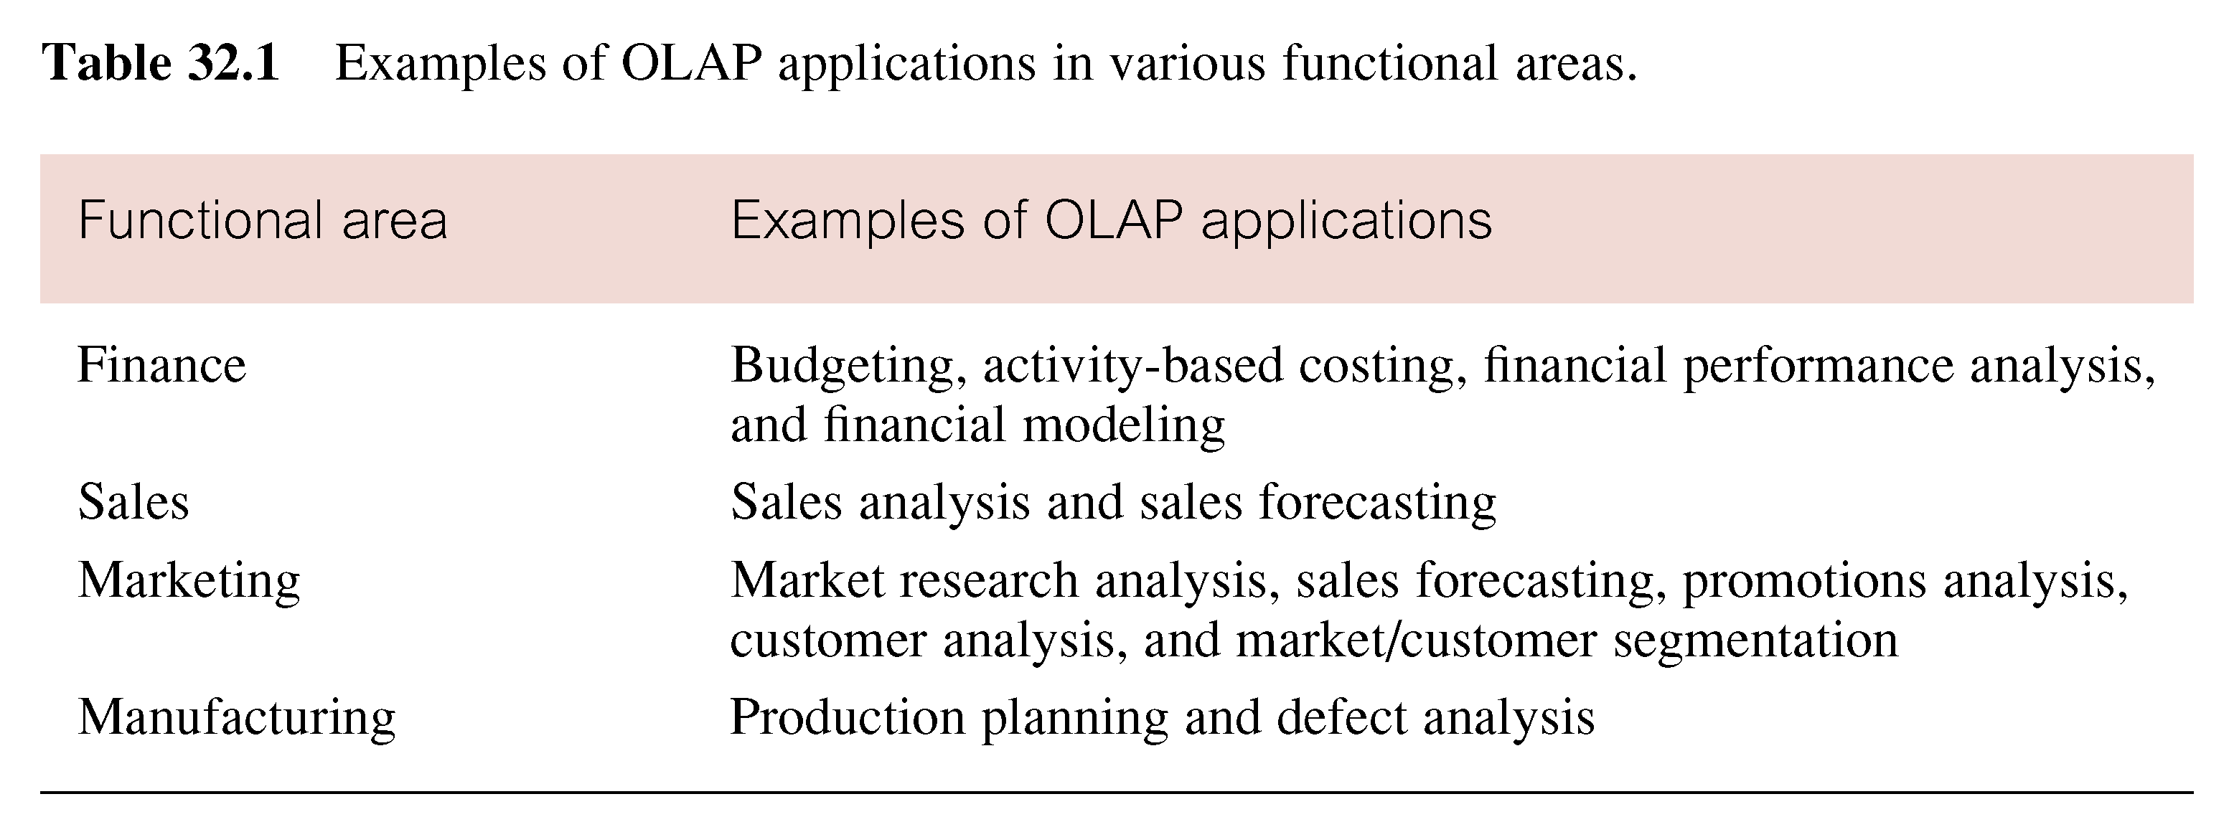
Examples of OLAP Applications in Various Functional Areas

Slide 11
OLAP Applications
Although OLAP applications are found in widely divergent functional areas, all have following key features:
  multi-dimensional views of data;
  support for complex calculations;
  time intelligence.

Slide 12
Representing Multi-Dimensional Data
Example of two-dimensional query.
  What is the total revenue generated by property sales in each city, in each quarter of 1997?’
Choice of representation is based on types of queries end-user may ask.
Compare representation - three-field relational table versus two-dimensional matrix.

Slide 13
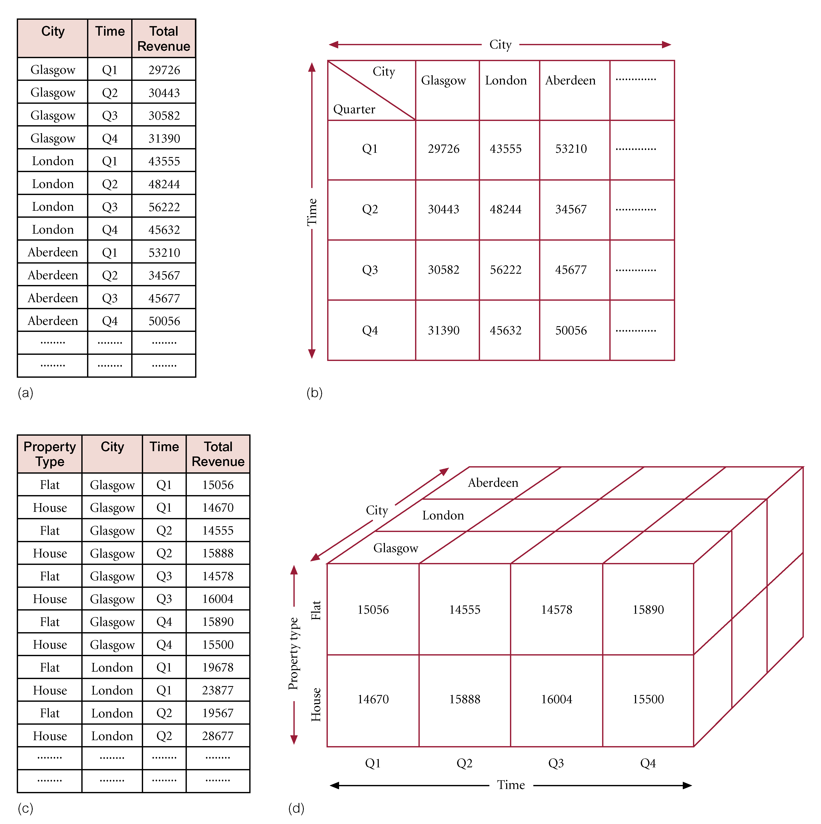
Multi-Dimensional Data as Three-Field Table versus Two-Dimensional Matrix

Slide 14
Representing Multi-Dimensional Data
Example of three-dimensional query.
  ‘What is the total revenue generated by property sales for each type of property (Flat or House) in each city, in each quarter of 1997?’
Compare representation - four-field relational table versus three-dimensional cube.

Slide 15
Multi-Dimensional Data as Four-Field Table versus Three-Dimensional Cube

Slide 16
Representing Multi-Dimensional Data
Cube represents data as cells in an array.
Relational table only represents multi-dimensional data in two dimensions.

Slide 17
Multi-Dimensional OLAP Servers
Use multi-dimensional structures to store data and relationships between data.
Multi-dimensional structures are best visualized as cubes of data, and cubes within cubes of data. Each side of cube is a dimension.
A cube can be expanded to include other dimensions.

Slide 18
Multi-Dimensional OLAP Servers
A cube supports matrix arithmetic.
Multi-dimensional query response time depends on how many cells have to be added ‘on the fly’.
As number of dimensions increases, number of the cube’s cells increases exponentially.

Slide 19
Multi-Dimensional OLAP Servers
However, majority of multi-dimensional queries use summarized, high-level data.
Solution is to pre-aggregate (consolidate) all logical subtotals and totals along all dimensions.
Pre-aggregation is valuable, as typical dimensions are hierarchical in nature.
  (e.g. Time dimension hierarchy - years, quarters, months, weeks, and days)

Slide 20
Multi-Dimensional OLAP Servers
Predefined hierarchy allows logical pre-aggregation and, conversely, allows for a logical ‘drill-down’.
Supports common analytical operations
  Consolidation.
  Drill-down.
  Slicing and dicing.

Slide 21
Multi-Dimensional OLAP Servers
Consolidation - aggregation of data such as simple ‘roll-ups’ or complex expressions involving inter-related data.
Drill-Down - is reverse of consolidation and involves displaying the detailed data that comprises the consolidated data.
Slicing and Dicing - (also called pivoting) refers to the ability to look at the data from different viewpoints.

Slide 22
Multi-Dimensional OLAP servers
Can store data in a compressed form by dynamically selecting physical storage organizations and compression techniques that maximize space utilization.
Dense data (i.e., data that exists for high percentage of cells) can be stored separately from sparse data (i.e., significant percentage of cells are empty).

Slide 23
Multi-Dimensional OLAP Servers
Ability to omit empty or repetitive cells can greatly reduce the size of the cube and the amount of processing.
Allows analysis of exceptionally large amounts of data.

Slide 24
Multi-Dimensional OLAP Servers
In summary, pre-aggregation, dimensional hierarchy, and sparse data management can significantly reduce the size of the cube and the need to calculate values ‘on-the-fly’.
Removes need for multi-table joins and provides quick and direct access to arrays of data, thus significantly speeding up execution of multi-dimensional queries.

Slide 25
OLAP Extensions to SQL
SQL promoted as easy to learn, non-procedural, free-format, DBMS-independent, and international standard.
However, major disadvantage has been inability to represent many of the questions most commonly asked by business analysts.
IBM and Oracle jointly proposed OLAP extensions to SQL early in 1999, adopted as an amendment to SQL.

Slide 26
OLAP Extensions to SQL
Many database vendors including IBM, Oracle, Informix, and Red Brick Systems have already implemented portions of specifications in their DBMSs.
Red Brick Systems was first to implement many essential OLAP functions (as Red Brick Intelligent SQL (RISQL)), albeit in advance of the standard.

Slide 27
OLAP Extensions to SQL - RISQL
Designed for business analysts.
Set of extensions that augments SQL with a variety of powerful operations appropriate to data analysis and decision-support applications such as ranking, moving averages, comparisons, market share, this year versus last year.

Slide 28
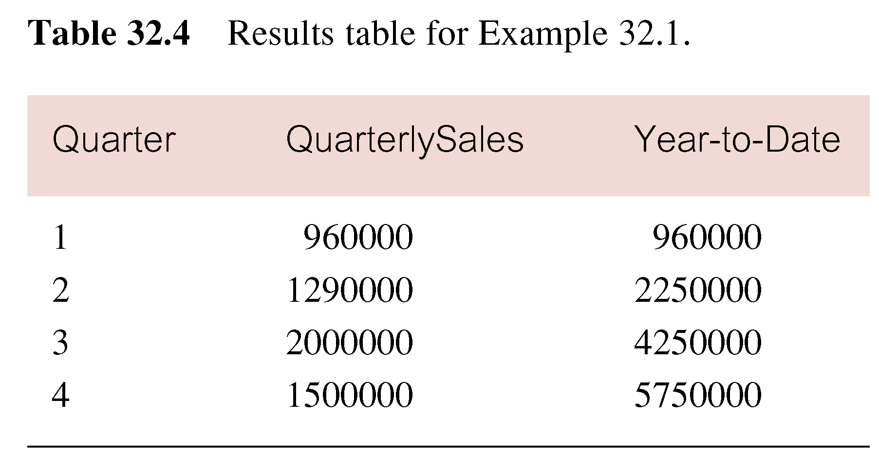
Use of the RISQL CUME Function
Show the quarterly sales for branch office B003, along with the monthly year-to-date figures.
  SELECT quarter, quarterlySales, CUME(quarterlySales) AS Year-to-Date
  FROM BranchSales
  WHERE branchNo = ‘B003’;

Slide 29
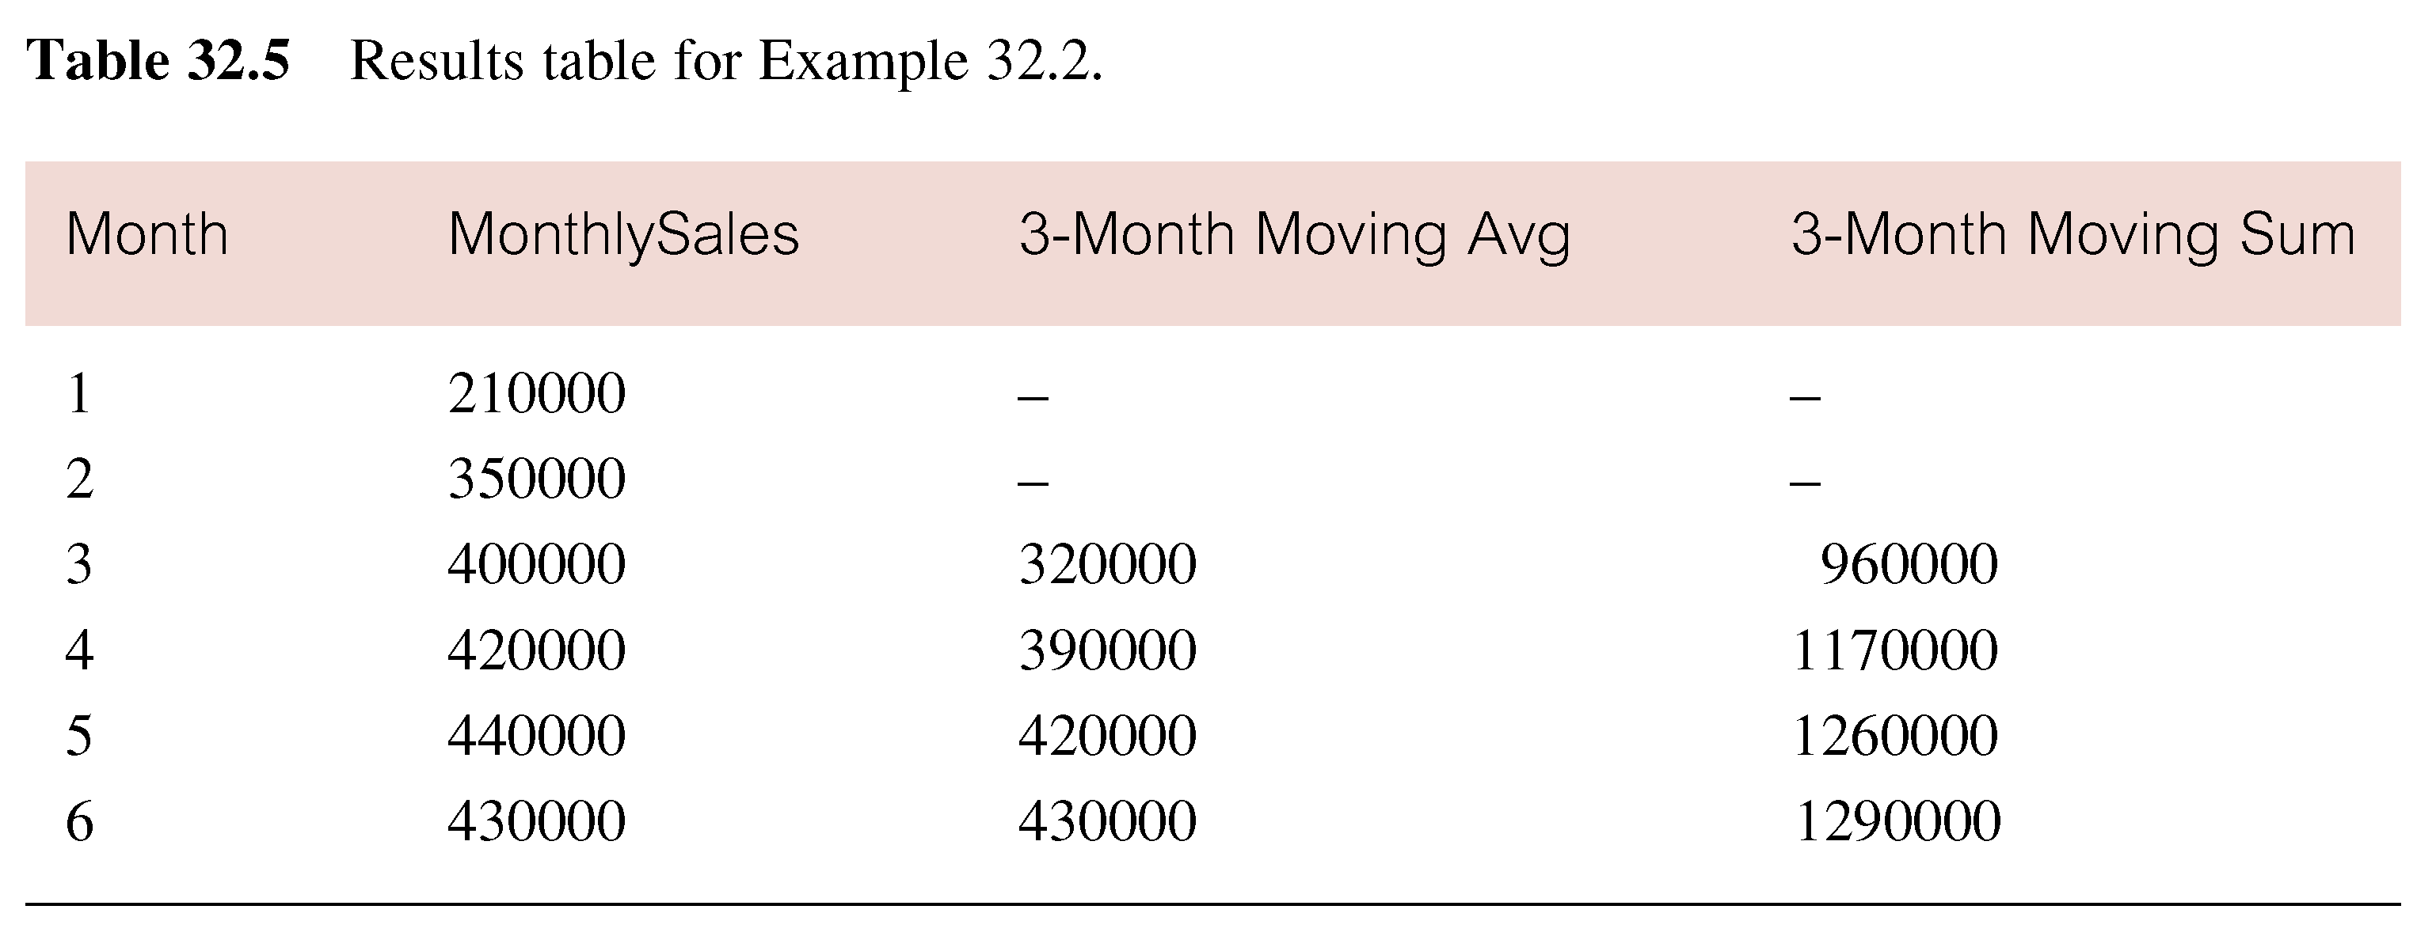
Use of the RISQL MOVINGAVG / MOVINGSUM Function
Show the first six monthly sales for branch office B003 without the effect of seasonality.
SELECT month, monthlySales,
  MOVINGAVG(monthlySales) AS 3-MonthMovingAvg,
  MOVINGSUM(monthlySales) AS 3-MonthMovingSum
  FROM BranchSales
  WHERE branchNo = ‘B003’;

Slide 30
Data Mining
The process of extracting valid, previously unknown, comprehensible, and actionable information from large databases and using it to make crucial business decisions (Simoudis, 1996).
Involves analysis of data and use of software techniques for finding hidden and unexpected patterns and relationships in sets of data.

Slide 31
Data Mining
Reveals information that is hidden and unexpected, as little value in finding patterns and relationships that are already intuitive.
Patterns and relationships are identified by examining the underlying rules and features in the data.
Tends to work from the data up and most accurate results normally require large volumes of data to deliver reliable conclusions.

Slide 32
Data Mining
Starts by developing an optimal representation of structure of sample data, during which time knowledge is acquired and extended to larger sets of data.
Data mining can provide huge paybacks for companies who have made a significant investment in data warehousing.
Relatively new technology, however already used in a number of industries.

Slide 33
Examples of Applications of Data Mining
Retail / Marketing
  Identifying buying patterns of customers.
  Finding associations among customer demographic characteristics.
  Predicting response to mailing campaigns.
  Market basket analysis.

Slide 34
Examples of Applications of Data Mining
Banking
  Detecting patterns of fraudulent credit card use.
  Identifying loyal customers.
  Predicting customers likely to change their credit card affiliation.
  Determining credit card spending by customer groups.

Slide 35
Examples of Applications of Data Mining
Insurance
  Claims analysis.
  Predicting which customers will buy new policies.
Medicine
  Characterizing patient behavior to predict surgery visits.
  Identifying successful medical therapies for different illnesses.

Slide 36
Data Mining Operations
Four main operations include:
  Predictive modeling.
  Database segmentation.
  Link analysis.
  Deviation detection.
There are recognized associations between the applications and the corresponding operations.
  e.g. Direct marketing strategies use database segmentation.

Slide 37
Data Mining Techniques
Techniques are specific implementations of the data mining operations.
Each operation has its own strengths and weaknesses.
Data mining tools sometimes offer a choice of operations to implement a technique.

Slide 38
Data Mining Techniques
Criteria for selection of tool includes
  Suitability for certain input data types.
  Transparency of the mining output.
  Tolerance of missing variable values.
  Level of accuracy possible.
  Ability to handle large volumes of data.

Slide 39
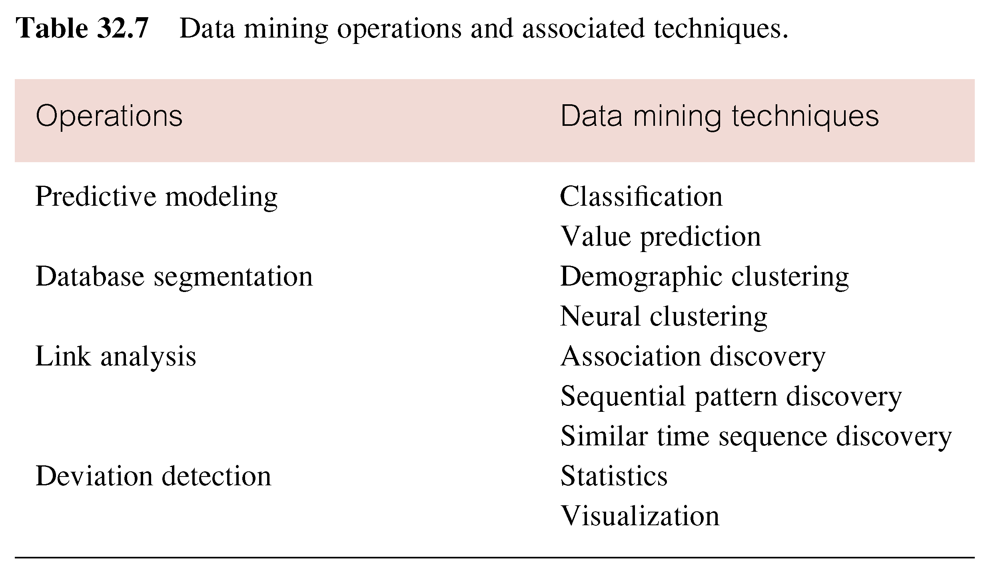
Data Mining Operations and Associated Techniques

Slide 40
Predictive Modeling
Similar to the human learning experience
  uses observations to form a model of the important characteristics of some phenomenon.
Uses generalizations of ‘real world’ and ability to fit new data into a general framework.
Can analyze a database to determine essential characteristics (model) about the data set.

Slide 41
Predictive Modeling
Model is developed using a supervised learning approach, which has two phases: training and testing.
  Training builds a model using a large sample of historical data called a training set.
  Testing involves trying out the model on new, previously unseen data to determine its accuracy and physical performance characteristics.

Slide 42
Predictive Modeling
Applications of predictive modeling include customer retention management, credit approval, cross selling, and direct marketing.
Two techniques associated with predictive modeling: classification and value prediction, distinguished by nature of the variable being predicted.

Slide 43
Predictive Modeling - Classification
Used to establish a specific predetermined class for each record in a database from a finite set of possible class values.
Two specializations of classification: tree induction and neural induction.

Slide 44
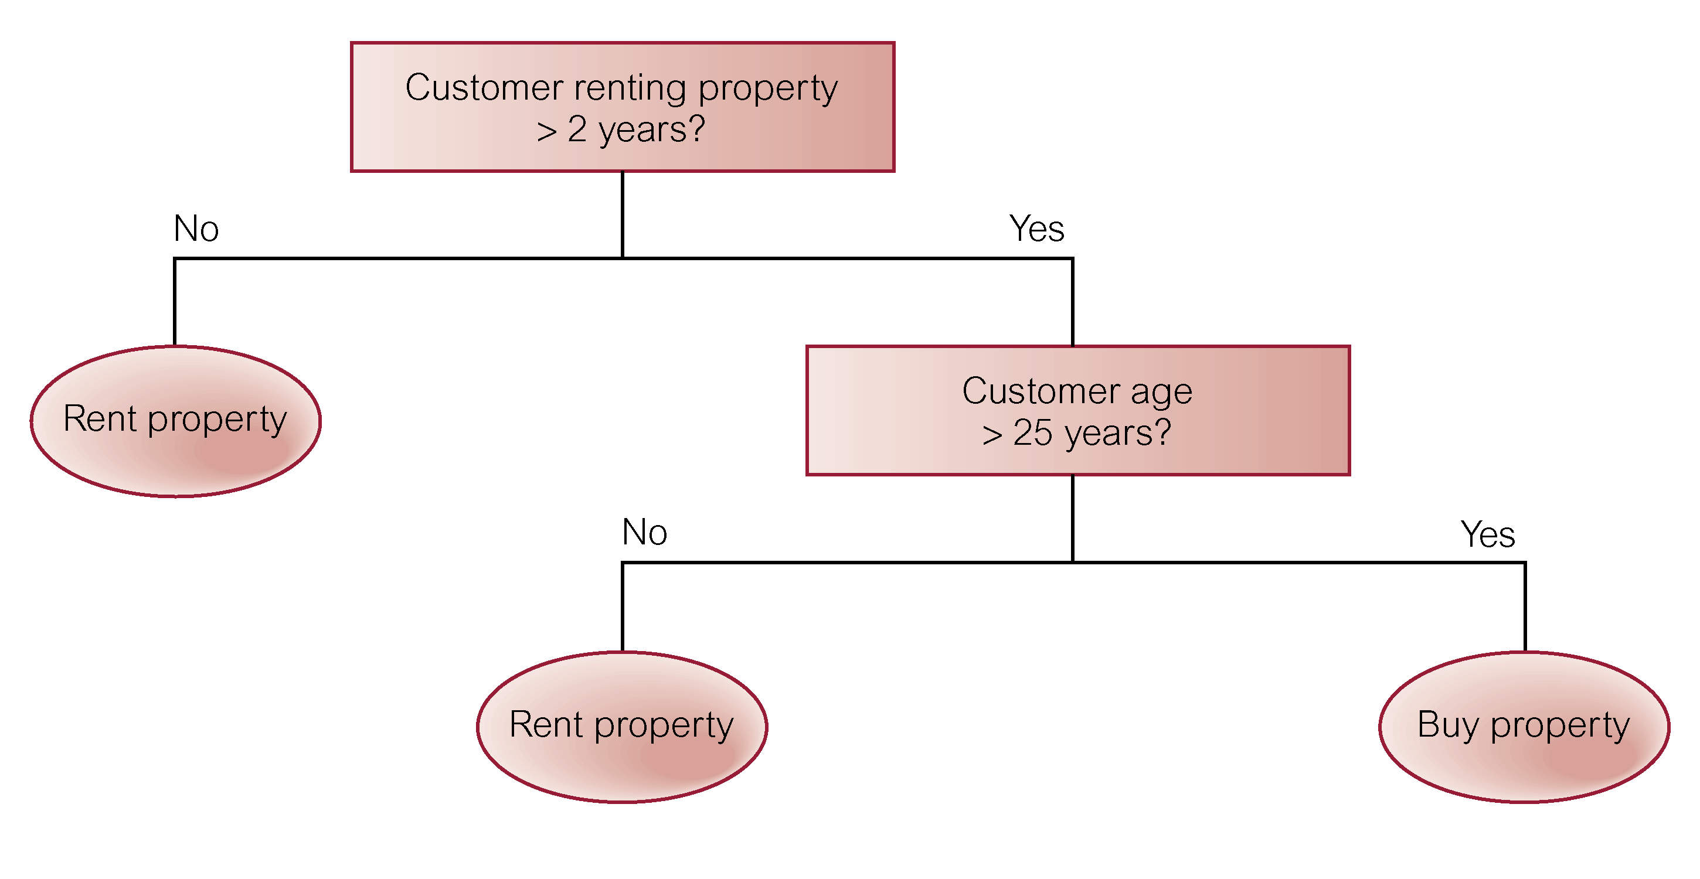
Example of Classification using Tree Induction

Slide 45
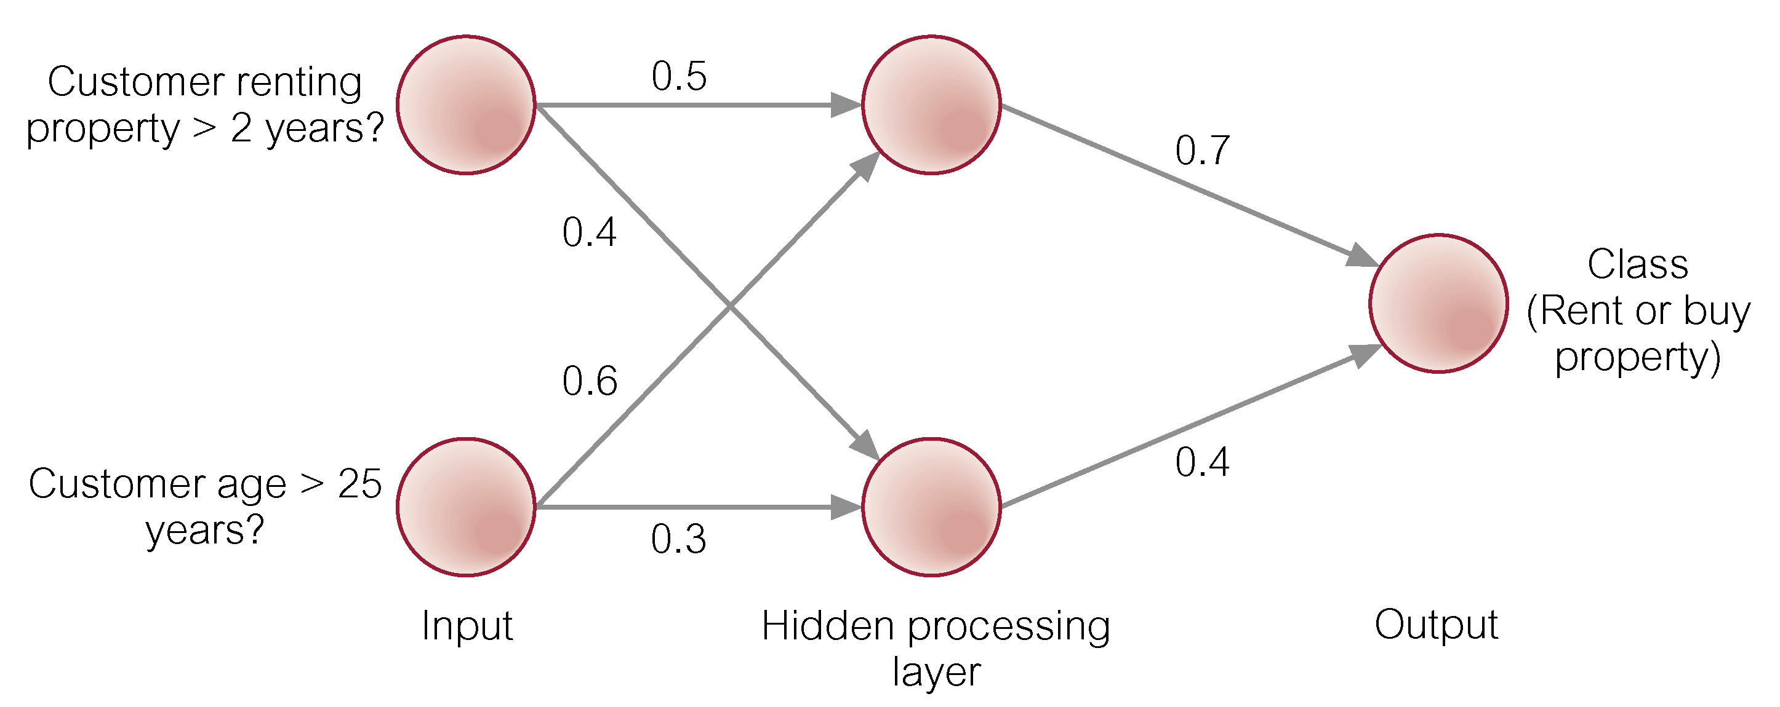
Example of Classification using Neural Induction

Slide 46
Predictive Modeling - Value Prediction
Used to estimate a continuous numeric value that is associated with a database record.
Uses the traditional statistical techniques of linear regression and nonlinear regression.
Relatively easy to use and understand.

Slide 47
Predictive Modeling - Value Prediction
Linear regression attempts to fit a straight line through a plot of the data, such that the line is the best representation of the average of all observations at that point in the plot.
Problem is that the technique only works well with linear data and is sensitive to the presence of outliers (i.e., data values, which do not conform to the expected norm).

Slide 48
Predictive Modeling - Value Prediction
Although nonlinear regression avoids the main problems of linear regression, still not flexible enough to handle all possible shapes of the data plot.
Statistical measurements are fine for building linear models that describe predictable data points, however, most data is not linear in nature.

Slide 49
Predictive Modeling - Value Prediction
Data mining requires statistical methods that can accommodate non-linearity, outliers, and non-numeric data.
Applications of value prediction include credit card fraud detection or target mailing list identification.

Slide 50
Database Segmentation
Aim is to partition a database into an unknown number of segments, or clusters, of similar records.
Uses unsupervised learning to discover homogeneous sub-populations in a database to improve the accuracy of the profiles.

Slide 51
Database Segmentation
Less precise than other operations thus less sensitive to redundant and irrelevant features.
Sensitivity can be reduced by ignoring a subset of the attributes that describe each instance or by assigning a weighting factor to each variable.
Applications of database segmentation include customer profiling, direct marketing, and cross selling.

Slide 52
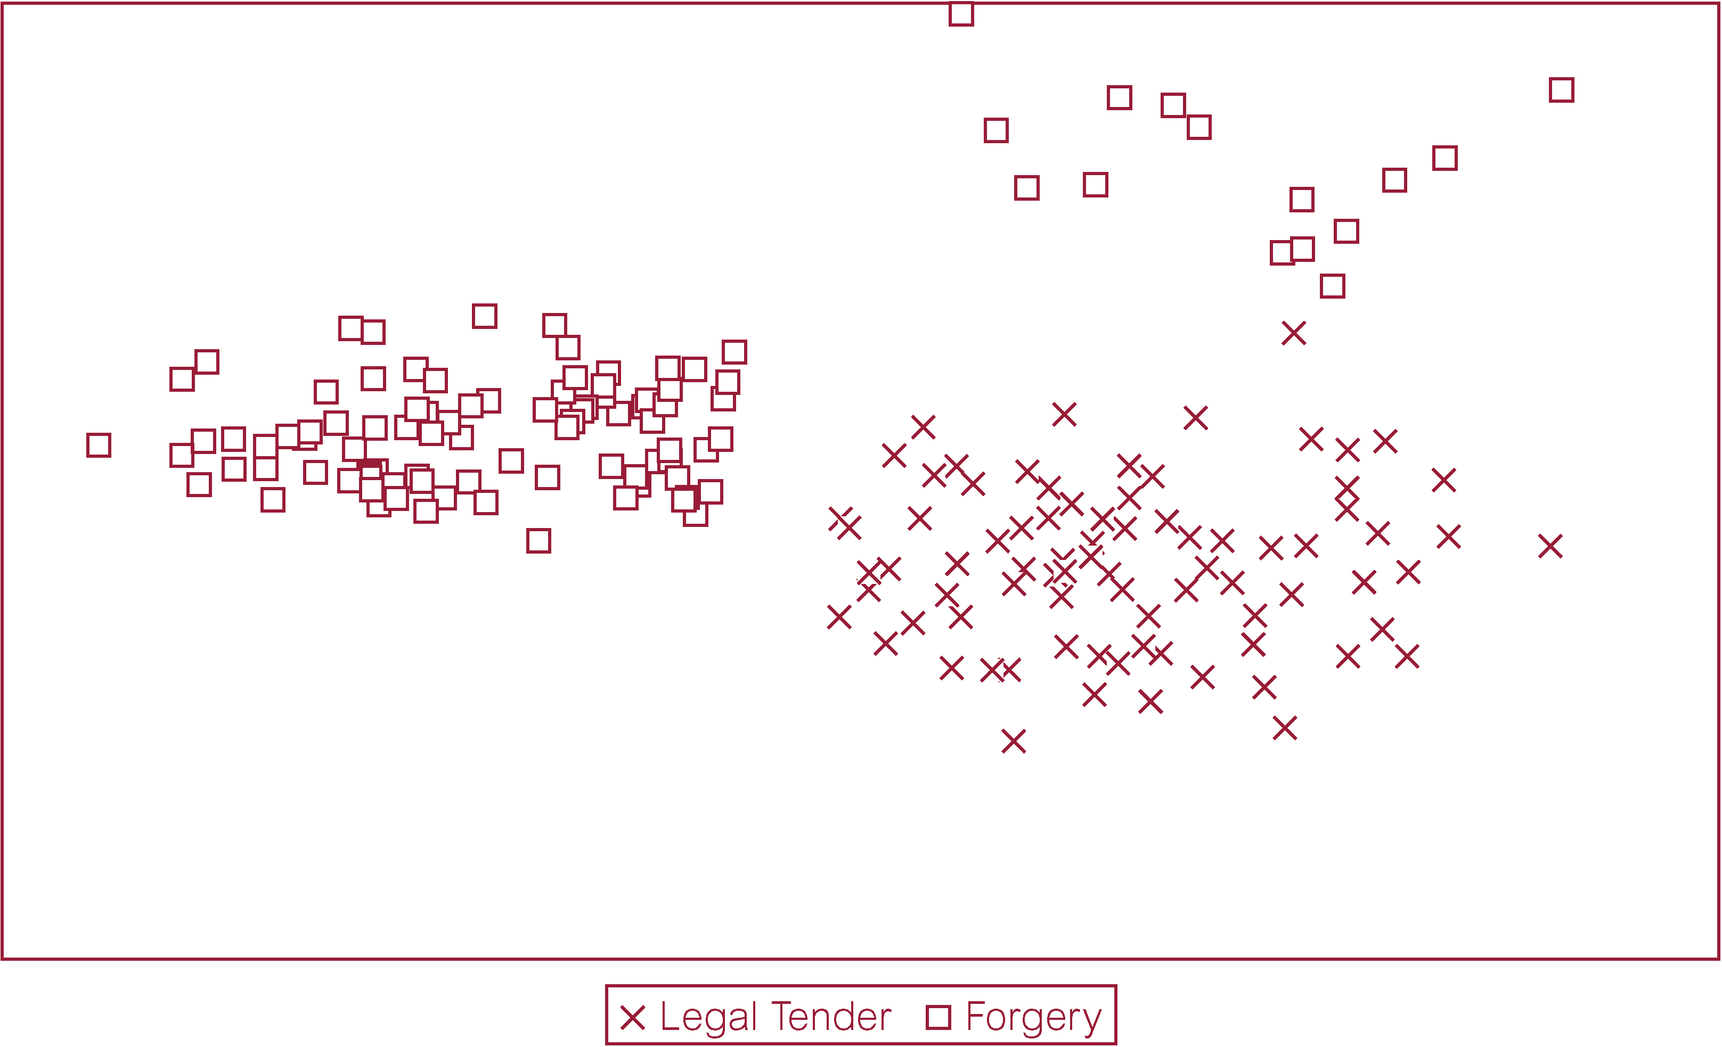
Example of Database Segmentation using a Scatterplot

Slide 53
Database Segmentation
Associated with demographic or neural clustering techniques, distinguished by:
  Allowable data inputs.
  Methods used to calculate the distance between records.
  Presentation of the resulting segments for analysis.

Slide 54
Link Analysis
Aims to establish links (associations) between records, or sets of records, in a database.
There are three specializations
  Associations discovery.
  Sequential pattern discovery.
  Similar time sequence discovery.
Applications include product affinity analysis, direct marketing, and stock price movement.

Slide 55
Link Analysis - Associations Discovery
Finds items that imply the presence of other items in the same event.
Affinities between items are represented by association rules.
  e.g. ‘When customer rents property for more than 2 years and is more than 25 years old, in 40% of cases, customer will buy a property. Association happens in 35% of all customers who rent properties’.

Slide 56
Link Analysis - Sequential Pattern Discovery
Finds patterns between events such that the presence of one set of items is followed by another set of items in a database of events over a period of time.
  e.g. Used to understand long-term customer buying behavior.

Slide 57
Link Analysis - Similar Time Sequence Discovery
Finds links between two sets of data that are time-dependent, and is based on the degree of similarity between the patterns that both time series demonstrate.
  e.g. Within three months of buying property, new home owners will purchase goods such as cookers, freezers, and washing machines.

Slide 58
Deviation Detection
Relatively new operation in terms of commercially available data mining tools.
Often a source of true discovery because it identifies outliers, which express deviation from some previously known expectation and norm.

Slide 59
Deviation Detection
Can be performed using statistics and visualization techniques or as a by-product of data mining.
Applications include fraud detection in the use of credit cards and insurance claims, quality control, and defects tracing.

Slide 60
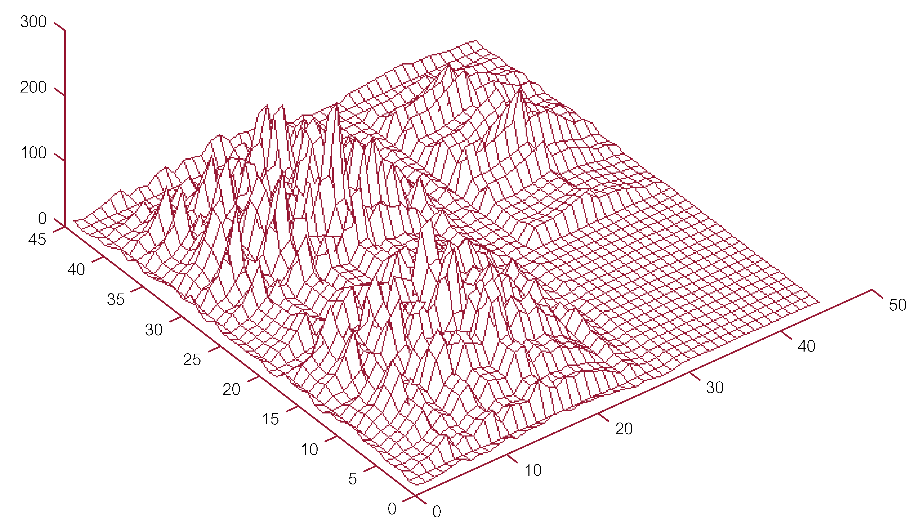
Example of Database Segmentation using a Visualization

Slide 61
Data Mining Tools
There are a growing number of commercial data mining tools on the marketplace.
Important characteristics of data mining tools include:
  Data preparation facilities.
  Selection of data mining operations.
  Product scalability and performance.
  Facilities for visualization of results.

Slide 62
Data Mining and Data Warehousing
Major challenge to exploit data mining is identifying suitable data to mine.
Data mining requires single, separate, clean, integrated, and self-consistent source of data.

Slide 63
Data Mining and Data Warehousing
A data warehouse is well equipped for providing data for mining.
Data quality and consistency is a prerequisite for mining to ensure the accuracy of the predictive models. Data warehouses are populated with clean, consistent data.

Slide 64
Data Mining and Data Warehousing
Advantageous to mine data from multiple sources to discover as many interrelationships as possible. Data warehouses contain data from a number of sources.
Selecting relevant subsets of records and fields for data mining requires query capabilities of the data warehouse.

Slide 65
Data Mining and Data Warehousing
Results of a data mining study are useful if there is some way to further investigate the uncovered patterns. Data warehouses provide capability to go back to the data source.

